Slide 1
Finding Structure with Randomness: Probabilistic Algorithms for Constructing Approximate Matrix Decompositions
By
N. Halko
P.G Martinsson
J.A. Tropp
Presented by Rene and Shuowen

Slide 2
Outline
Background
Motivations
Goals
Approximation by Low-Rank Matrices
Matrix Approximation Framework
Algorithm
Experiment
Reference

Slide 3
Background
Low-rank matrix approximations, such as the truncated singular value decomposition and the rank-revealing QR decomposition, play a central role in data analysis and scientiﬁc computing.
Recent research demonstrates that random
-ization oﬀers a powerful tool for performing
low-rank matrix approximation.

Slide 4
Disadvantages of Classical algorithm
A salient feature of modern applications, especially in data mining, is that the matrices are stupendously big. Classical algorithms are not always well adapted to solving the type of large-scale problems that now arise.
In the information sciences, it is common that data are missing or inaccurate.
Classical algorithms are designed to produce highly accurate matrix decompositions, but it seems proﬂigate to spend extra computational resources when the imprecision of the data inherently limits the resolution of the output.

Slide 5
Motivations
These techniques exploit modern computational architectures more fully than classical methods and open the possibility of dealing with truly massive data sets.

Slide 6
Goals
The purpose of this paper is make the case that randomized algorithms provide a powerful tool for constructing approximate matrix factorizations.
Our goal is to demonstrate how randomized methods interact with classical techniques to yield effective, modern algorithms supported by detailed theoretical guarantees.

Slide 7
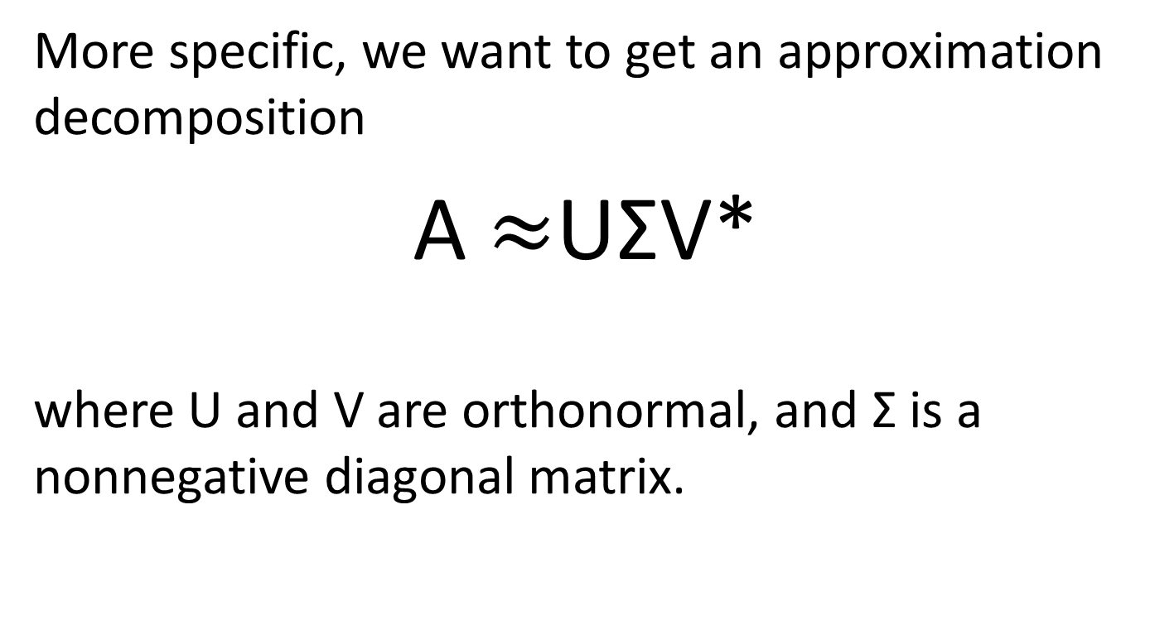
Goals
More specific, we want to get an approximation decomposition
A$≈$UΣV*
where U and V are orthonormal, and Σ is a nonnegative diagonal matrix.

Slide 8
Approximation by Low-Rank Matrices
The roster of standard matrix decompositions includes the pivoted QR factorization, the eigenvalue decomposition, and the singular value decomposition (SVD), all of which expose the (numerical) range of a matrix. Truncated versions of these factorizations are often used to express a low-rank approximation of a given matrix:
A ≈ B C (1.1)
m × n m × k k × n.
Def: The inner dimension k is sometimes called the numerical rank of the matrix.

Slide 9
Approximation by Low-Rank Matrices
When the numerical rank is much smaller than either dimension m or n, a factorization such as (1.1) allows the matrix to be stored inexpensively and to be multiplied rapidly with vectors or other matrices. The factorizations can also be used for data interpretation or to solve computational problems, such as least squares.

Slide 10
Matrix Approximation Framework
The task of computing a low-rank approximation to a given matrix can be split naturally into two computational stages:
The ﬁrst is to construct a low-dimensional subspace that captures the action of the matrix.
The second is to restrict the matrix to the subspace and then compute standard factorization (QR, SVD, etc.) of the reduced matrix. To be slightly more formal, we subdivide the computation as follows:

Slide 11
Matrix Approximation Framework
Stage A: Compute an approximate basis for the range of the input matrix A. In other words, we require a matrix Q for which
Q has orthonormal columns and A ≈ QQ*A (1.2)
We would like the basis matrix Q to contain as few columns as possible, but it is even more important to have an accurate approximation of the input matrix.
Stage B: Given a matrix Q that satisﬁes (1.2), we use Q to help compute a standard factorization (QR, SVD, etc.) of A.

Slide 12
Matrix Approximation Framework
It may not be clear why the output from Stage A facilitates our job in Stage B. Let us illustrate by describing how to obtain an approximate SVD of the input matrix A given a matrix Q that satisﬁes (1.2). More precisely, we wish to compute matrices U and V with orthonormal columns and a nonnegative, diagonal matrix Σ such that A ≈ UΣV*. This goal is achieved after three simple steps:
1. Form B=Q∗A, which yields the low-rank factorization A ≈ QB.
2. Compute an SVD of the small matrix: B = uΣV*.
3. Set U = Qu.

Slide 13
Problem Formulations
The basic challenge in producing low-rank matrix approximations is a primitive question that we call the ﬁxed-precision approximation problem. Suppose we are given a matrix A and a positive error tolerance ε.
We seek a matrix Q with k = k(ε) orthonormal columns such that
||A − QQ*A||≤ ε (1.3)
where ||·|| denotes the 2 operator norm. The range of Q is a k-dimensional subspace that captures most of the action of A, and we would like k to be as small as possible.

Slide 14
Aim of Stage A
We would like to find an approximate basis for the range of the input matrix of A. In other words, we require a matrix Q
Q has orthonormal columns
2. A ≈ QQ*A
Notes:
Remind

Slide 15
Stage A
Fixed-rank problem-Where the target rank of the input matrix is speciﬁed in advance we have a target numerical rank of matrix A. Algorithm 4.1
Fixed-precision problem-Where we do not know numerical rank of matrix A. Algorithm 4.2.
Decay slowly problem-Where the singular values of matrix A decay slowly.
Notes:
We will discuss 3 cases about the original matrix A.

Slide 16
Stage A
Algorithm 4.1 Randomized Range Finder
Given an m × n matrix A and an integer l, this scheme computes an m × l orthonormal matrix Q whose range approximates the range of A.
Note: The number of columns l that the algorithm needs to reach this threshold is usually slightly larger than the rank k of the smallest basis that veriﬁes
||A − QQ*A||≤ ε (1.3)

Slide 17
Stage A
Algorithm 4.1 Randomized Range Finder
Given an m × n matrix A and an integer , this scheme computes an m × l orthonormal matrix Q whose range approximates the range of A.
1. Draw an n × l Gaussian random matrix Ω.
2. Form the m× l matrix Y = AΩ.
3. Construct an m× l matrix Q whose columns form an orthonormal basis for the range of Y , e.g., using the QR factorization Y = QR.

Slide 18
Stage A
Algorithm 4.1 Randomized Range Finder
Why do we want to do that?
1. Draw an n × l Gaussian random matrix Ω.
2. Form the m× l matrix Y = AΩ.
The columns of Ω form a linearly independent set and no linear combination falls in the null space of A.
As a result,
The set of {y(i): i =1, 2,...,k} of sample vectors is also linearly independent, so it spans the range of A.
Therefore, to produce an orthonormal basis for the range
of A, we just need to orthonormalize the sample vectors.

Slide 19
Stage A
Algorithm 4.1 Randomized Range Finder
2. Form the m× l matrix Y = AΩ.
3. Construct an m× l matrix Q whose columns form an orthonormal basis for the range of Y , e.g., using the QR factorization Y = QR.
If Y has linearly independent columns (say n columns), then the first n columns of Q form an orthonormal basis for the column space of A. More specifically, the first k columns of Q form an orthonormal basis for the span of the first k columns of A for any 1≤k≤n.[1] ____this is from Wiki of QR decomposition.
Notes:
SO USE QR TO GET THE ORTHOGONAL MATRIX Q

Slide 20
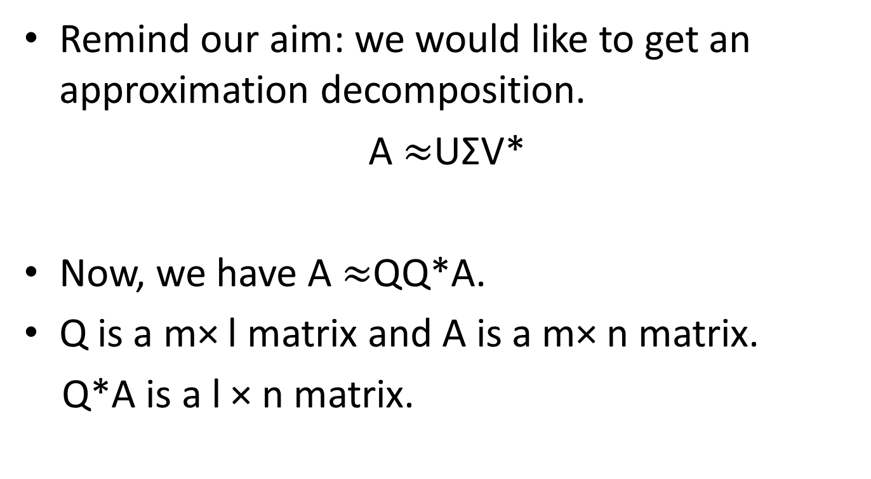
Stage B
Remind our aim: we would like to get an approximation decomposition.
A$≈$UΣV*
Now, we have A$≈$QQ*A.
Q is a m× l matrix and A is a m× n matrix.
Q*A is a l × n matrix.

Slide 21
Stage B
Algorithm 5.1 Direct SVD
Given matrices A and Q from stage A, this procedure computes an approximate factorization A ≈ UΣV*, where U and V are orthonormal, and Σ is a nonnegative diagonal matrix.
1. Form the matrix B = Q∗A.
2. Compute an SVD of the small matrix: B = uΣV*.
3. Form the orthonormal matrix U = Qu.

Slide 22
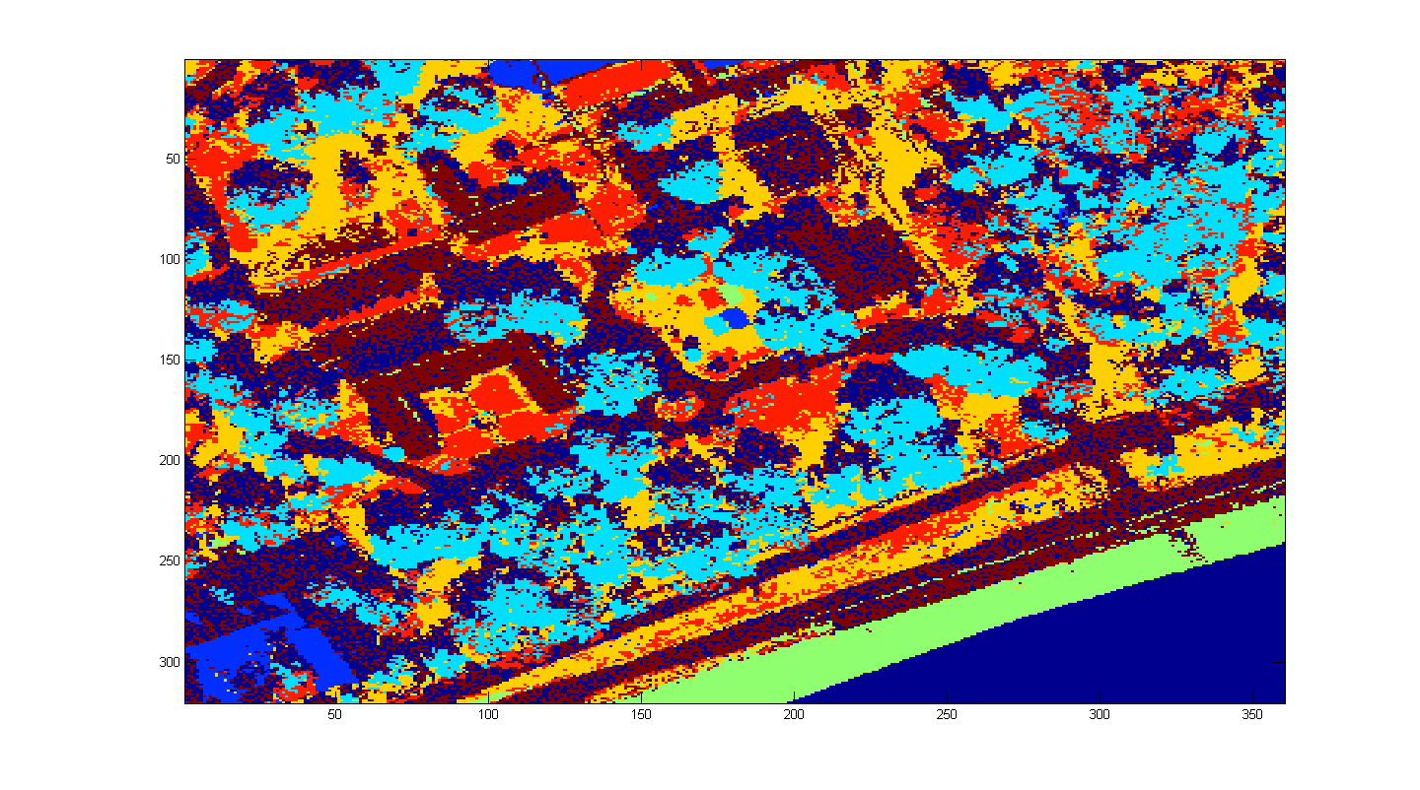
Application

Slide 23
Reference
[1] N. Halko, P. G. Martinsson, and J. A. Tropp, “Finding structure with randomness: Probabilistic algorithms for constructing approximate matrix decompositions,” SIAM Review, vol. 53, no. 2, pp. 217–288, 2011.
[2] http://en.wikipedia.org/wiki/QR_decomposition

